Slide 1
Hidden Markov Models
(Examples)
Donghai Guan
Kyung Hee University

Slide 2
Example of Markov Model
0.3
0.7
Rain
Dry
0.2
0.8
Two states : ‘Rain’ and ‘Dry’.
Transition probabilities:
P(‘Rain’|‘Rain’)=0.3 , P(‘Dry’|‘Rain’)=0.7 , P(‘Rain’|‘Dry’)=0.2, P(‘Dry’|‘Dry’)=0.8
Initial probabilities: say P(‘Rain’)=0.4 , P(‘Dry’)=0.6 .

Slide 3
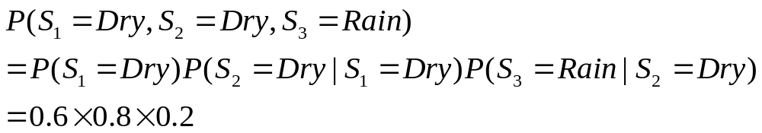
Calculation of sequence probability
Dry
Dry
Rain
Markov Model is just a Bayesian Network;
In this network, P(S1,S2,S3)=P(S1)P(S2|S1)P(S3|S2)

Slide 4
Hidden Markov Models
Based on Markov Models
Differences include
  State becomes “Hidden”
  The state information is not available, instead of, there are some “Observations” with are correlated with “Hidden” State

Slide 5
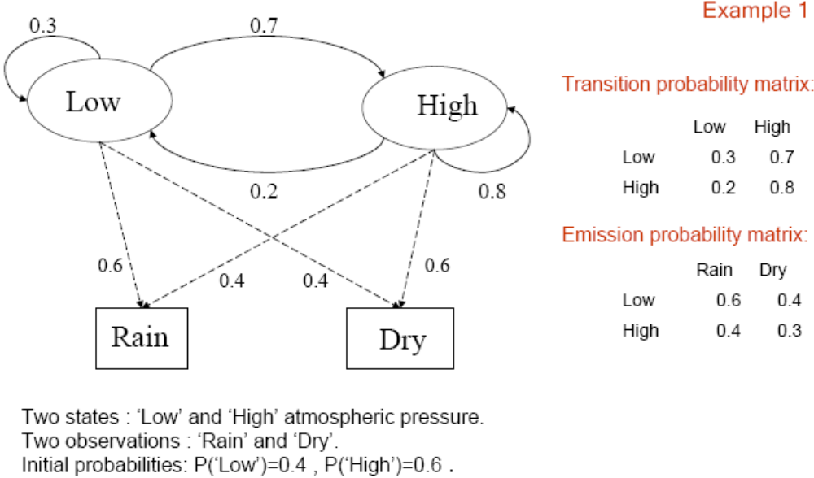
Hidden Markov Model
In Markov Model, Emission Prof. is not used

Slide 6
Problems can be solved using HMM
Calculation of observation sequence probability
S1
S2
S3
O1
O2
O3
Rain
Rain
Dry

Slide 7
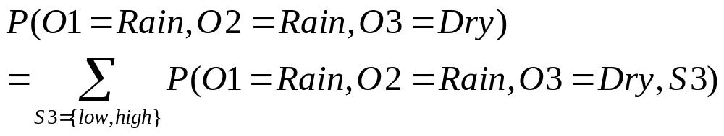
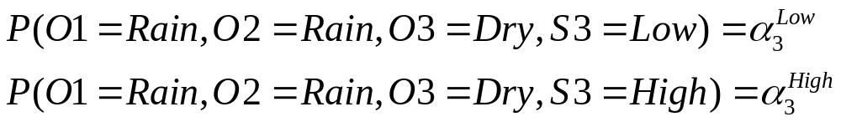
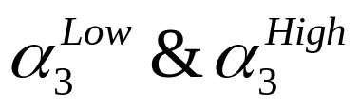
* Now the problem is how to calculate

Slide 8
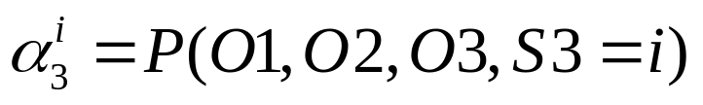
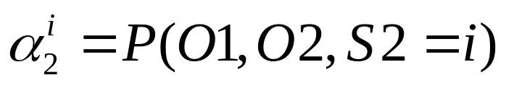
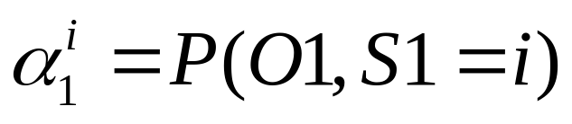
S1
S2
S3
O1
O2
O3
S1
S2
S3
O1
O2
O3
S1
S2
S3
O1
O2
O3

Slide 9
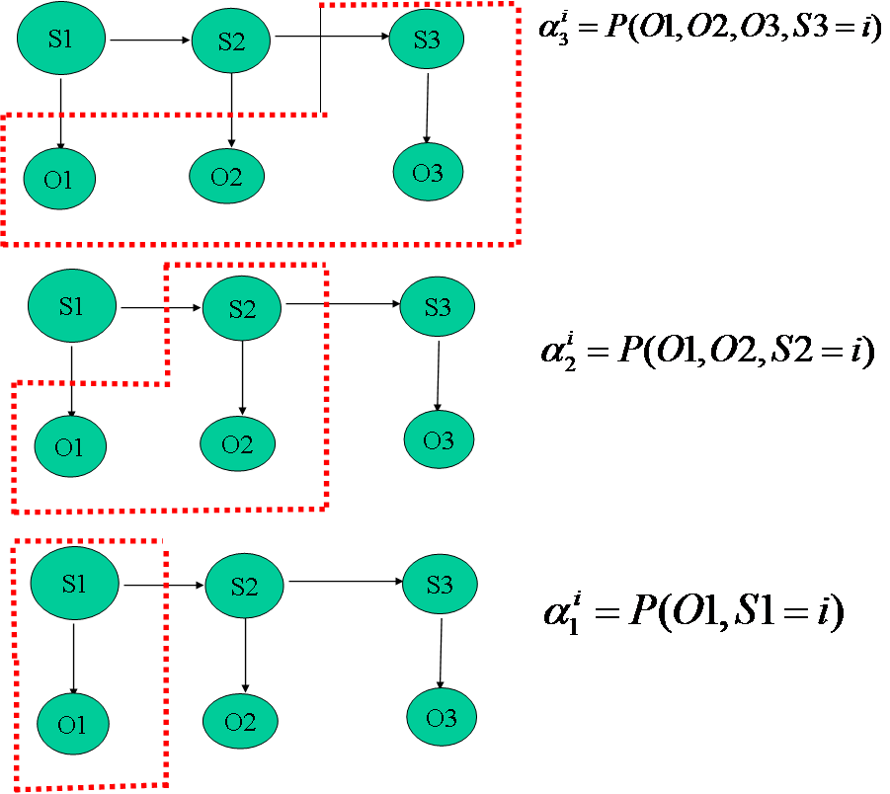
Calculation Difficulty

Slide 10
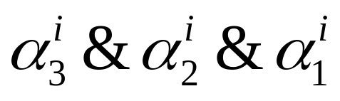



Can we find some relationship between
If we can find the relationship, then we can:
Calculate
Calculate based on
Calculate based on
Recursively!

Slide 11
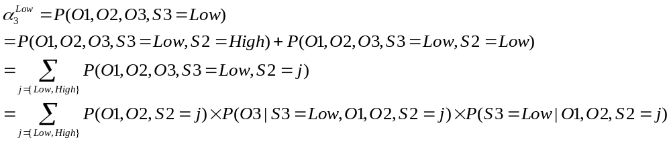


Can we find the relationship? (Yes)
D-Separation
S1
S2
S3
O1
O2
O3

Slide 12
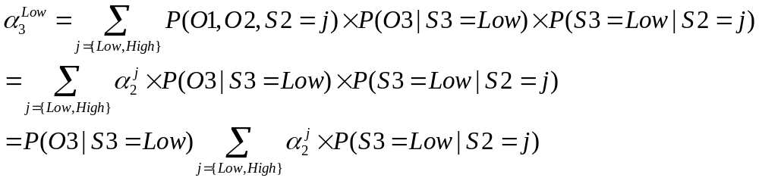
Forward Algorithm
Dynamic Programming
Emission Probability
Transition Probability

Slide 13
Problem can be Solved by HMM
Decoding problem 1
S1
S2
S3
S4
O1
O2
O3
O4
P(O1,O2,O3,O4,S3=High)=?

Slide 14
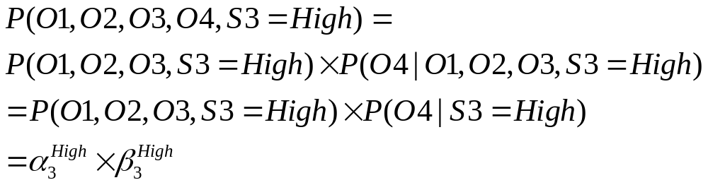
？
We already know how to calculate it.

Slide 15
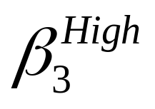
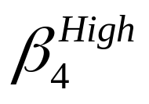
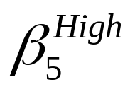
S1
S2
S3
S4
S5
S6
O1
O2
O3
O4
O5
O6
S1
S2
S3
S4
S5
S6
Calculation Difficulty
O1
O2
O3
O4
O5
O6
S1
S2
S3
S4
S5
S6
O1
O2
O3
O4
O5
O6

Slide 16
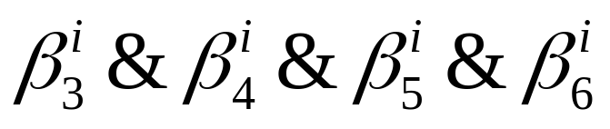
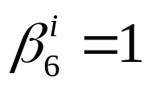



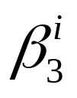
Can we find some relationship among
If we can find the relationship, then we can:
Calculate
Calculate based on
Calculate based on
Calculate based on
Recursively!

Slide 17
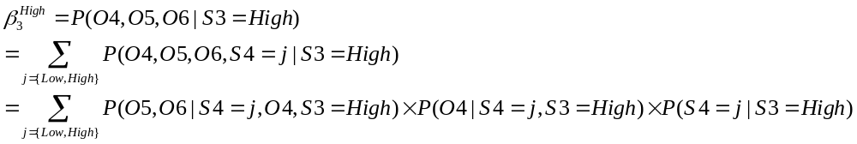


Can we find the relationship? (Yes)
D-Separation
S1
S2
S3
S4
S5
S6
O1
O2
O3
O4
O5
O6

Slide 18
Backward Algorithm
Emission Prob.
Transition Prob.

Slide 19
Decoding Problem 2
S1
S2
S3
O1
O2
O3
Rain
Rain
Dry
O1,O2,O3 are known, what is the most probable sequence S1,S2,S3
For example: {High, High, Low}, {Low, High, Low}, {Low, High, High}…….

Slide 20
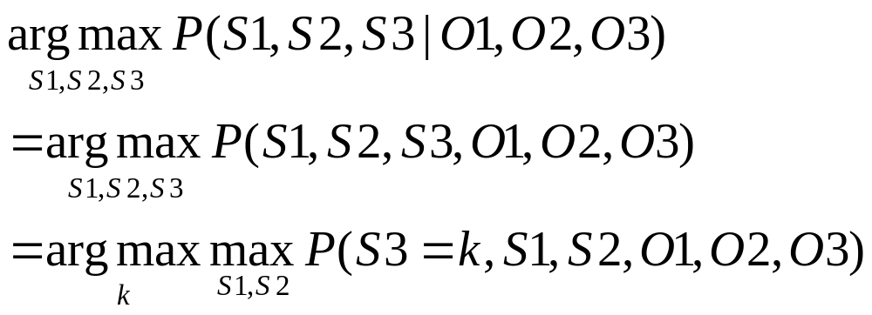
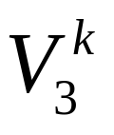
Probability of most likely sequence of states ending at states S3=k

Slide 21
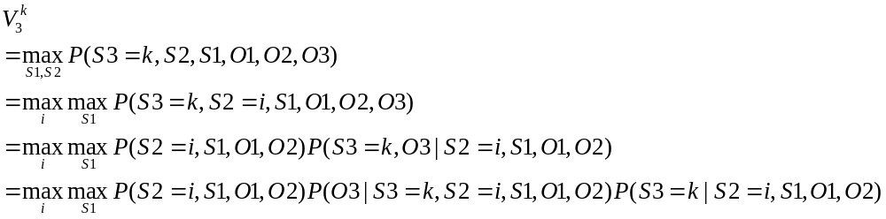
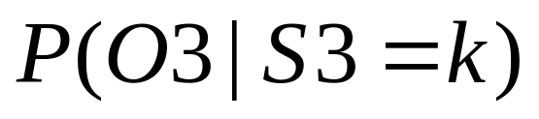
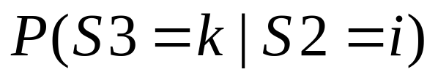
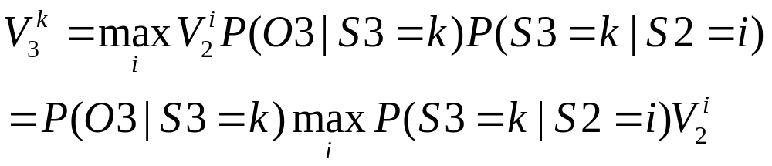
D-Separation

Slide 22
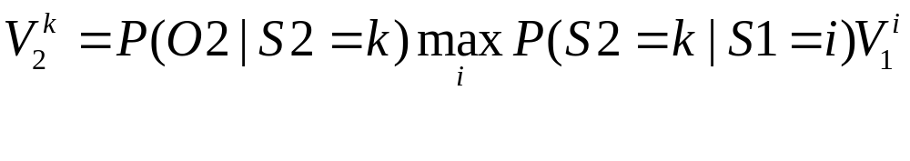
Viterbi algorithm

Slide 23
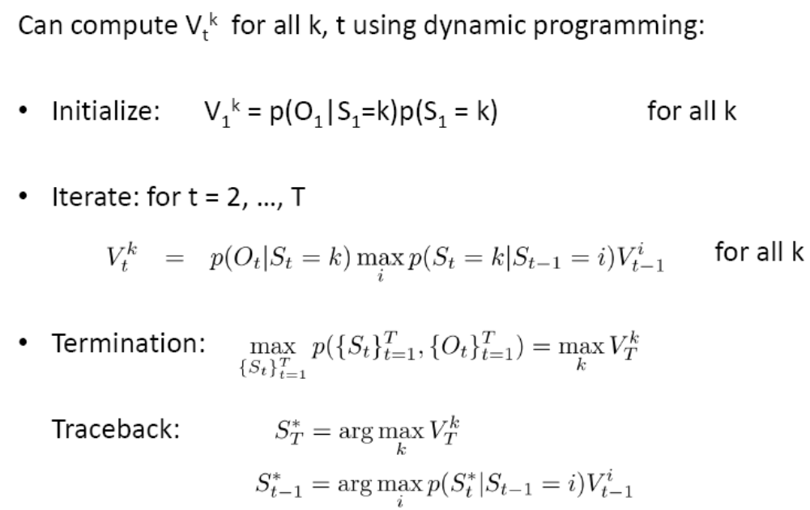
Viterbi algorithm

Slide 24
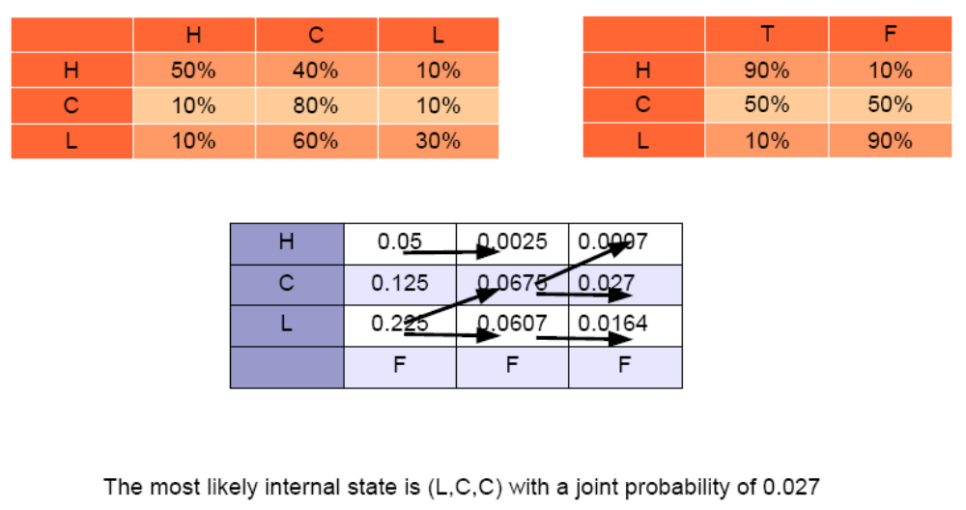
Viterbi algorithm

Slide 25
Problem can be Solved by HMM
Learning algorithm
S1
S2
S3
O1
O2
O3
What is the transition probability, P(High|Low)=?, P(Low|High)=?
What is the emission probability, P(Dry|High)=? P(Dry|Low)=?
What is the initial probability, P(S1=High)=?

Slide 26
Baum-Welch Algorithm (EM)
Start with random initialization of parameters
 | Low | High
Low | 0.6 | 0.4
High | 0.3 | 0.7
 | Rain | Dry
Low | 0.7 | 0.3
High | 0.4 | 0.6

Slide 27
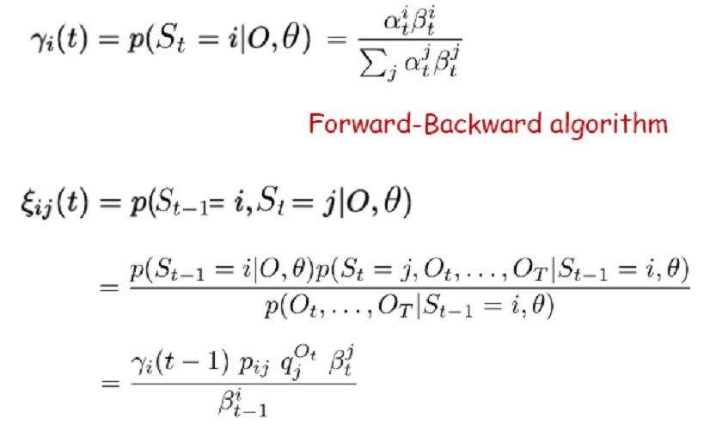
Baum-Welch Algorithm (EM)
E-Step

Slide 28
